Slide 1
Library management system
Team:
Ivana Brankovic
Bozidar Grabovcic
Milos Drljaca
Vukasin Simic
Zoran Kovacevic
Aleksandar Stojmenovic
Marko Petrovic

Slide 2
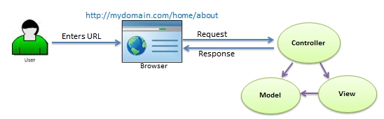
Technologies and architecture
ASP.NET framework
MVC architectural pattern

Slide 3
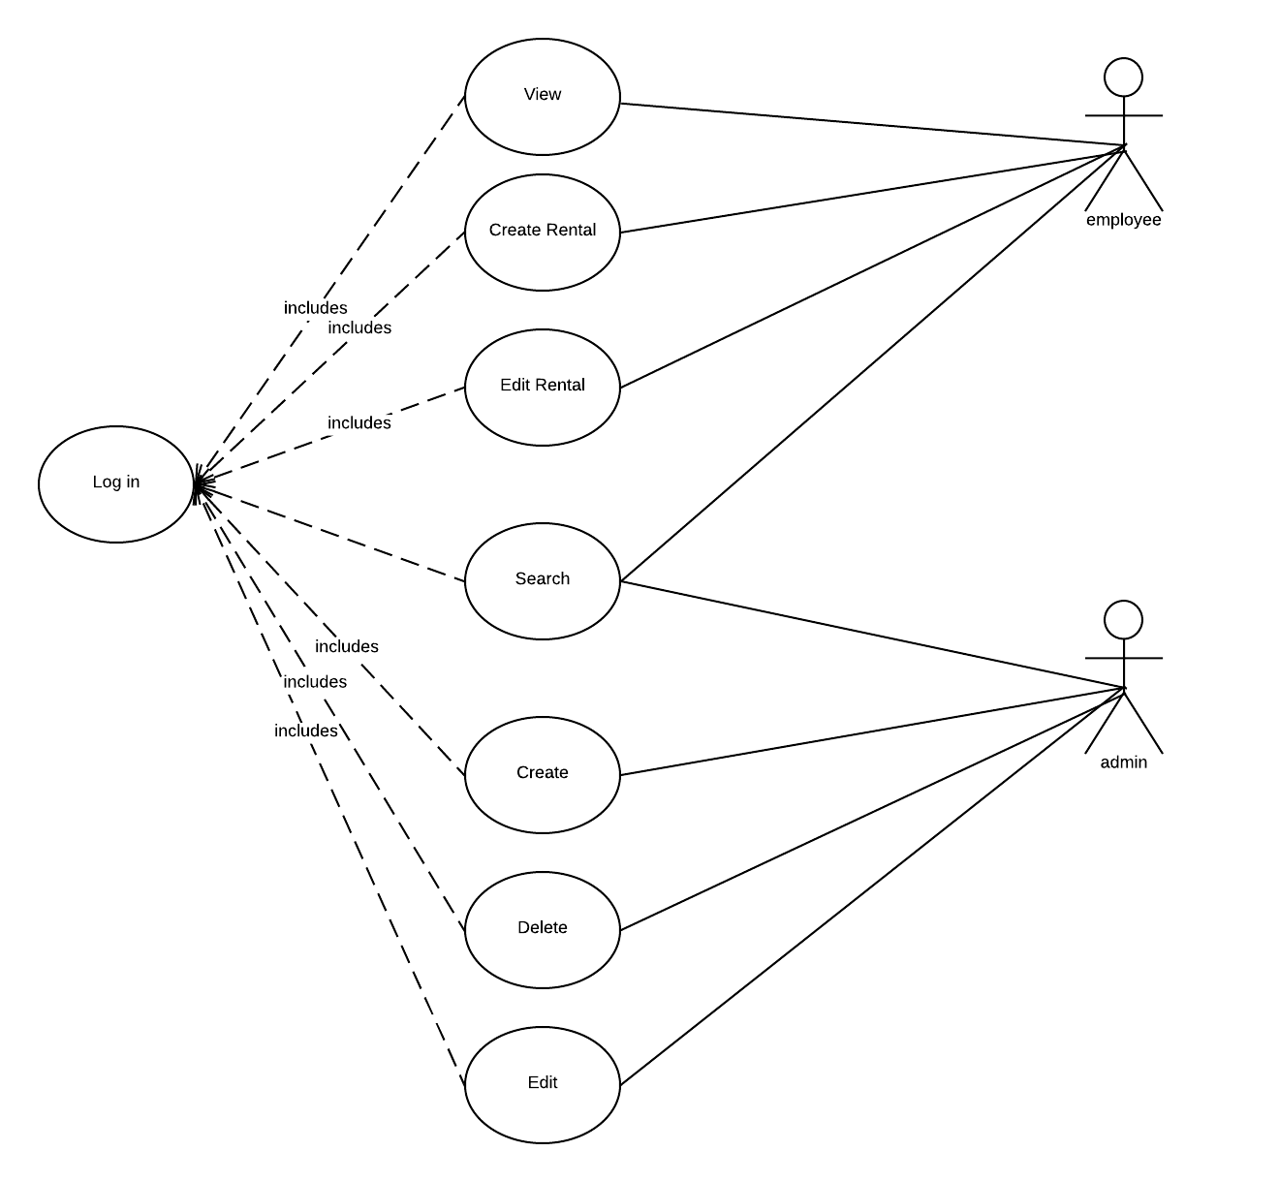
Use case diagram

Slide 4
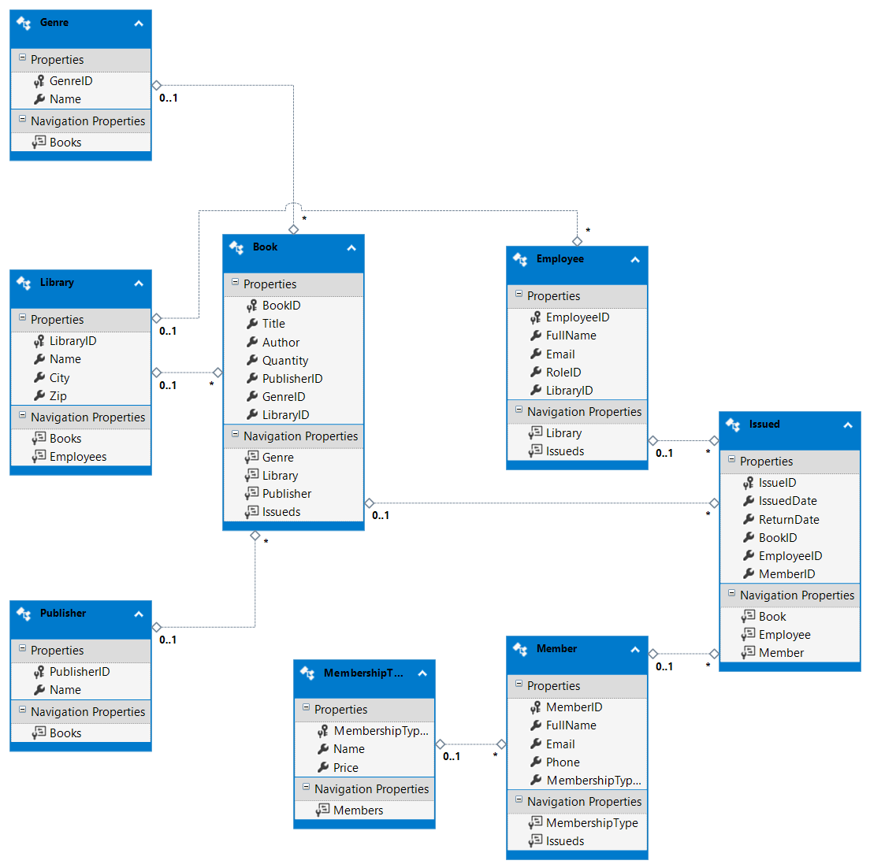
Database
MS SQL
Microsoft Management SQL Studio

Slide 5
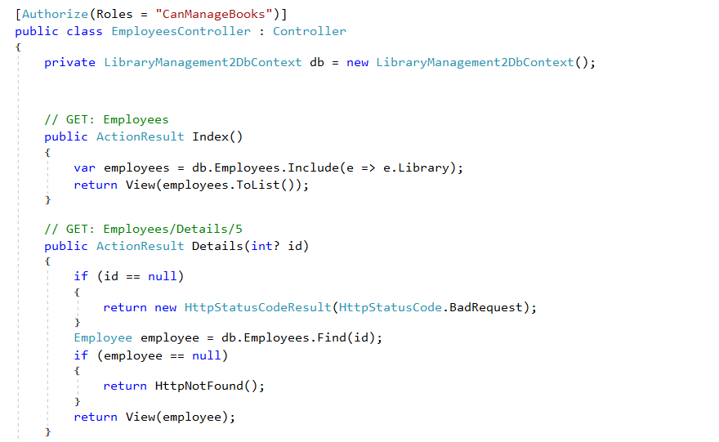
Identity framework
Using [Authorize] and [AllowAnonymous] attributes can determ who can acces and make changes on our data.

Slide 6
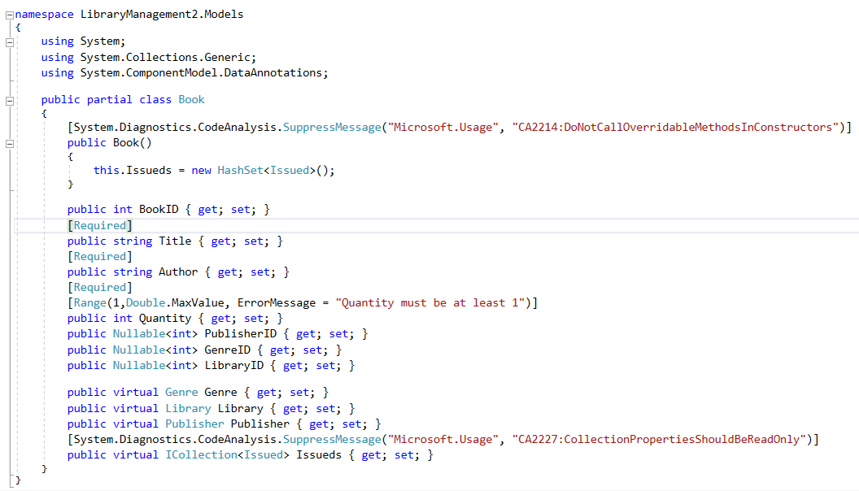
Models
Entity framework?
Database first approach?

Slide 7
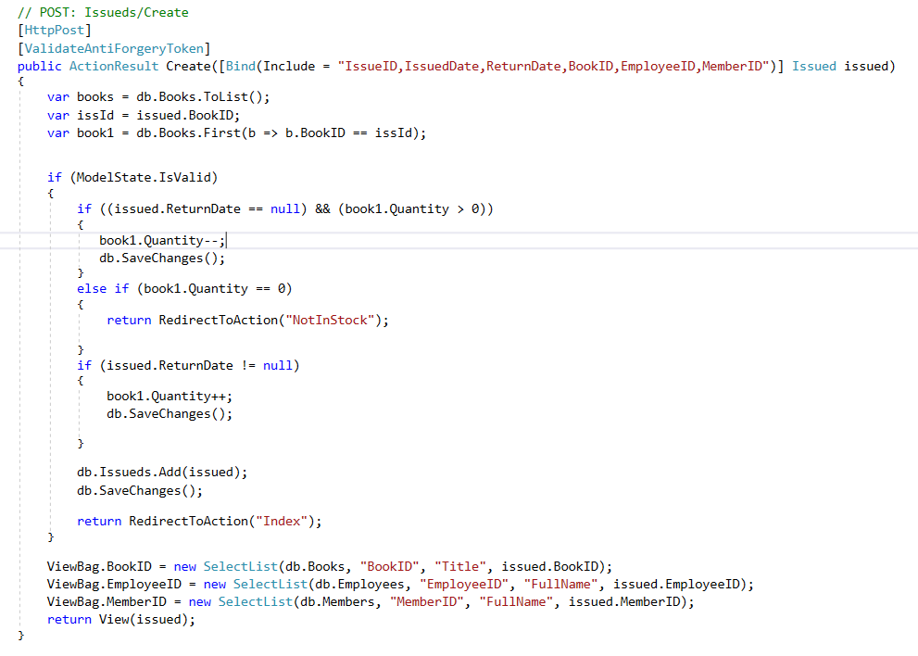
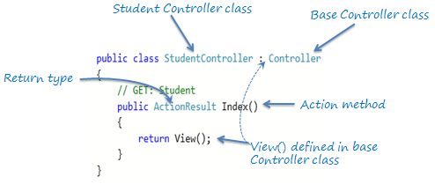
Controllers
The Controller in MVC architecture handles any incoming URL request.
Action methods ?

Slide 8
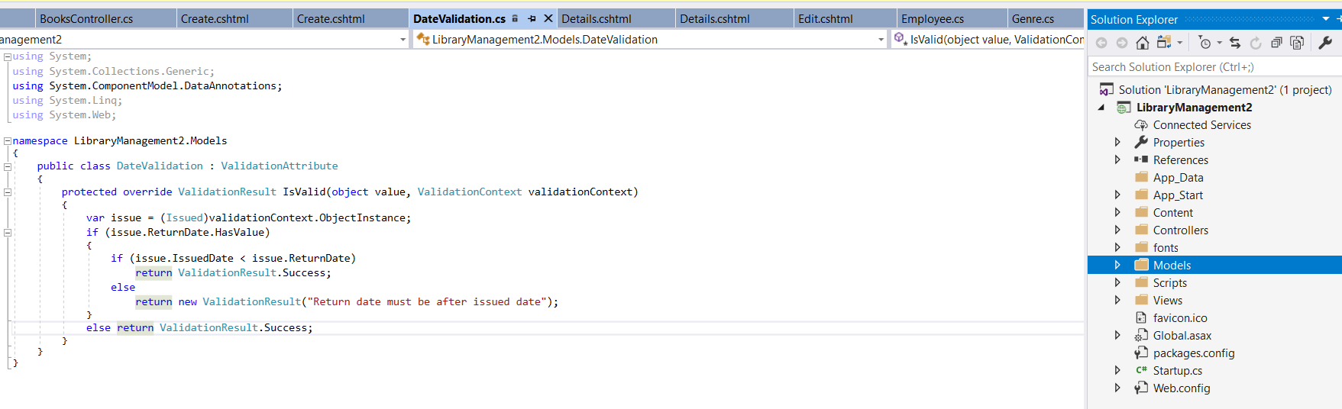
Custom validation
Custom validation using validation attribute class

Slide 9
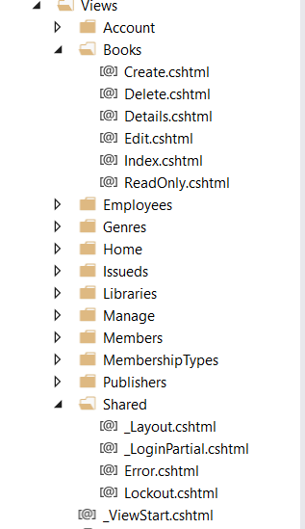
Views
View displays data from the model to the user and also enables them to modify the data.
Razor View

Slide 10
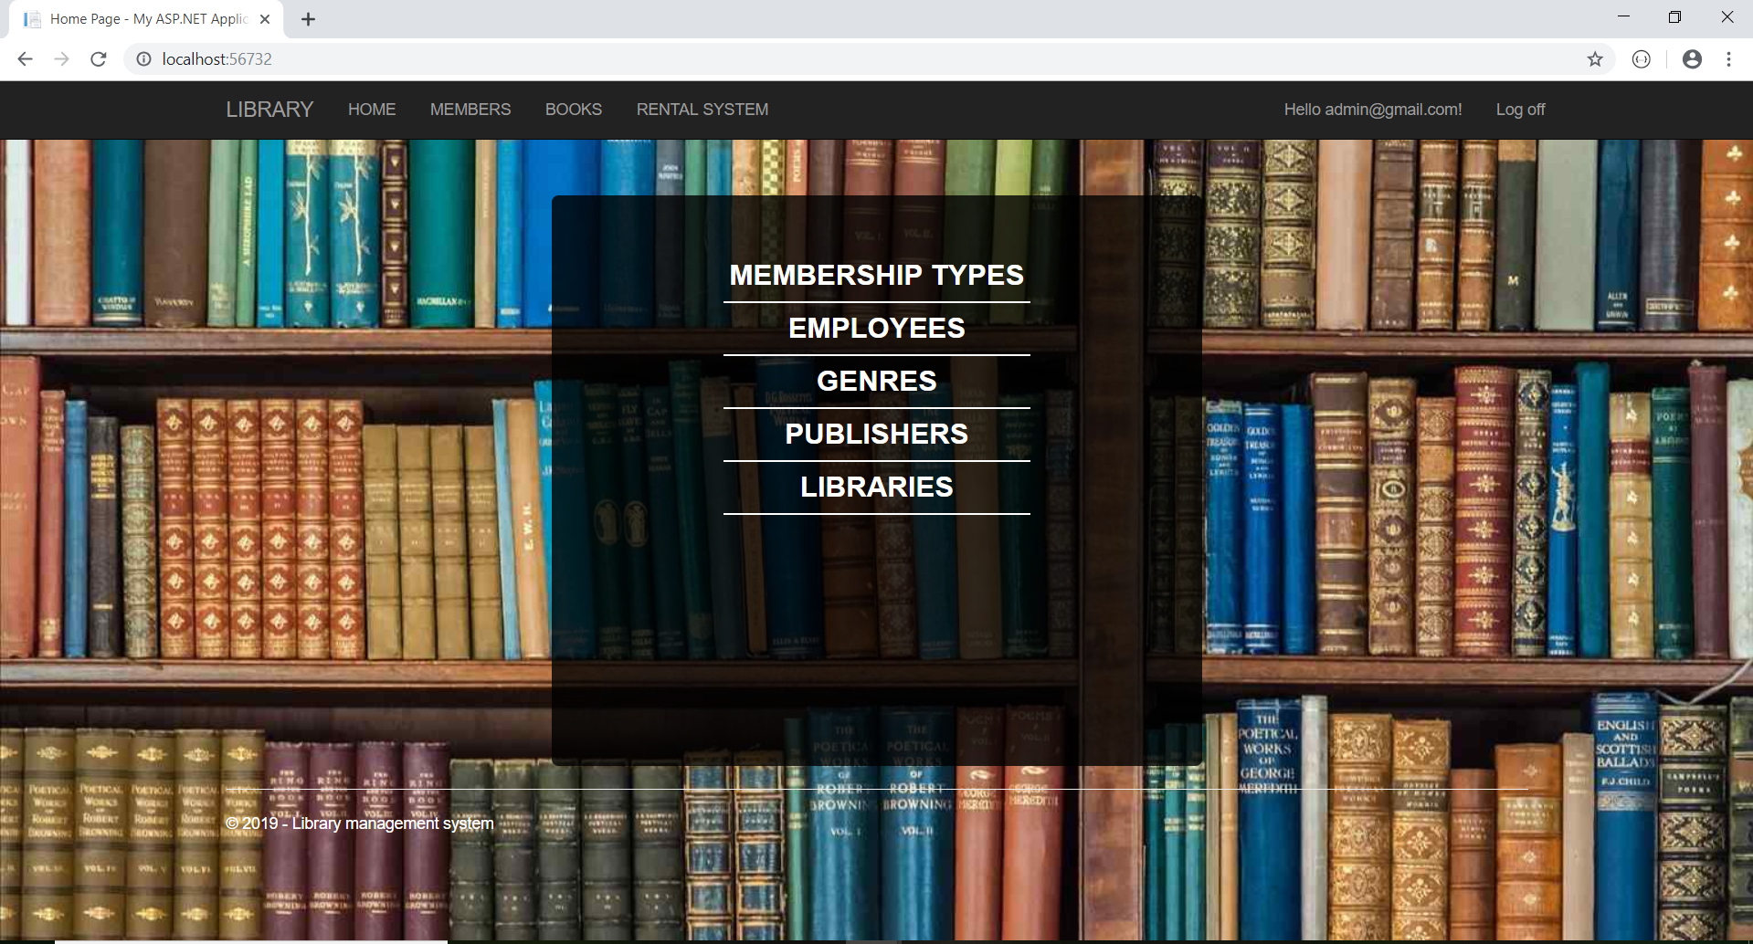
Admin home page

Slide 11

Employee home page

Slide 12
THE END
Thank you for your attention

